Slide 1
New York 311 Call Center
Luis Barriere
Narinder Singh
Maurice Tut
Mauricio Franco

Slide 2
Agenda
311 Intro
Project Specs
Data Source
The Data - At a Glance
311 Call Analysis – Findings
Conclusion

Slide 3

311 Introduction
311 is a non-emergency phone number that serves the public and handles all requests like finding information about services(DMV etc.), make complaints (noise etc.), or report problems like graffiti or road damage to help them best.
In this project, we focus on analyzing the New York 311 calls that were made between 2007 to 2009 to gain insight on call types, frequency, and location.

Slide 4

Project Specifications
Utilizing Oracle Cloud Big Data Compute Edition
Hive Version 1.2.1000.2.4.2.0-258 Apache
6 Node (cis5200Spr19)-180GB Memory – 682GB Storage
Microsoft Power BI
Microsoft Excel
Git Bash

Slide 5
Dataset
New York 311 Call Center Data 2.7GB
https://data.cityofnewyork.us/api/views/aiww-p3af/rows.csv?accessType=DOWNLOAD
https://data.cityofnewyork.us/api/views/uzcy-9puk/rows.csv?accessType=DOWNLOAD
https://data.cityofnewyork.us/api/views/3rfa-3xsf/rows.csv?accessType=DOWNLOAD
https://github.com/lab1213/cis5200

Slide 6
The Data

Slide 7
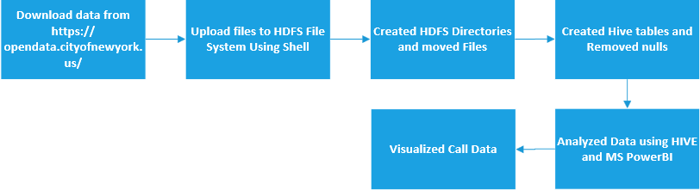
Workflow

Slide 8
Tables and Data Processing
Creating Hive table to query NY 311 data
Note:
The TBLPROPERTIES('serialization.null.format'='') is used to fill in blank fields with NULL values that can later be omitted from the dataset. This way, only relevant data is retained.
CREATE EXTERNAL TABLE IF NOT EXISTS ny311data(
unique_key STRING,
created_date STRING,
closed_date STRING,
agency STRING,
agency_name STRING,
Created HIVE tables
Various rows with missing/blank data needed to be identified for analysis

Slide 9
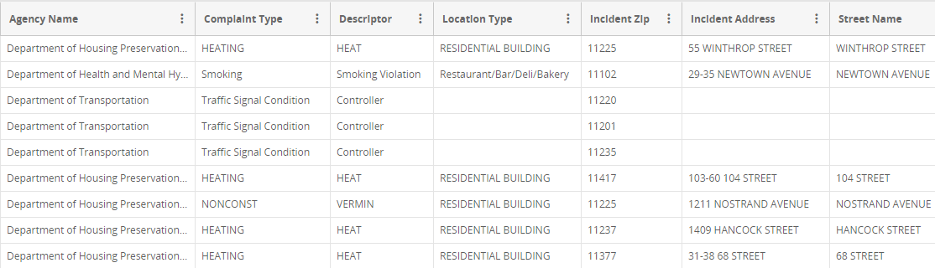
Dirty Data

Slide 10
Cleanup
INSERT OVERWRITE TABLE complaints
SELECT created_date, complaint_type, city, incident_zip, borough
FROM ny311data
WHERE city IS NOT NULL
AND incident_zip IS NOT NULL;

Slide 11
The Findings

Slide 12
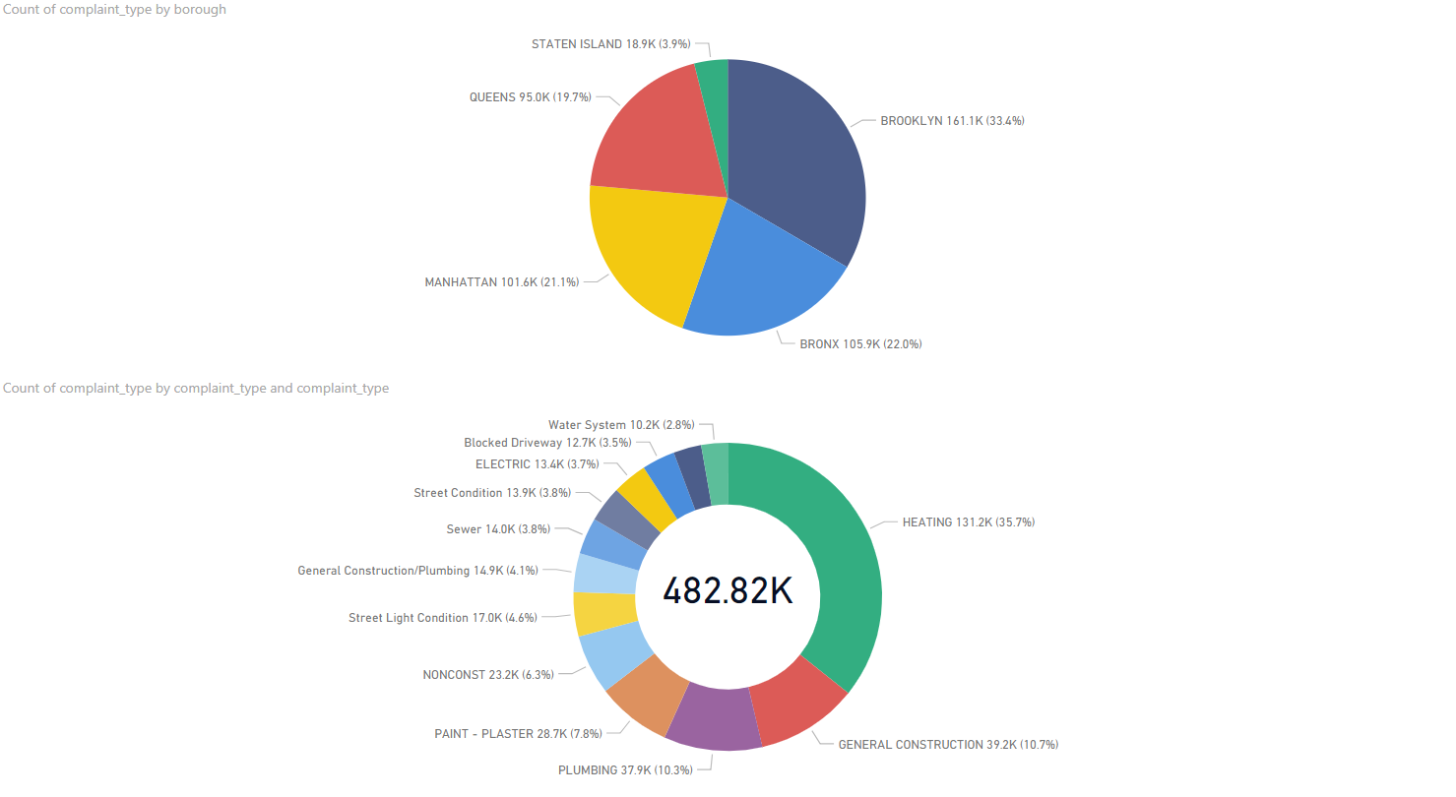

Slide 13
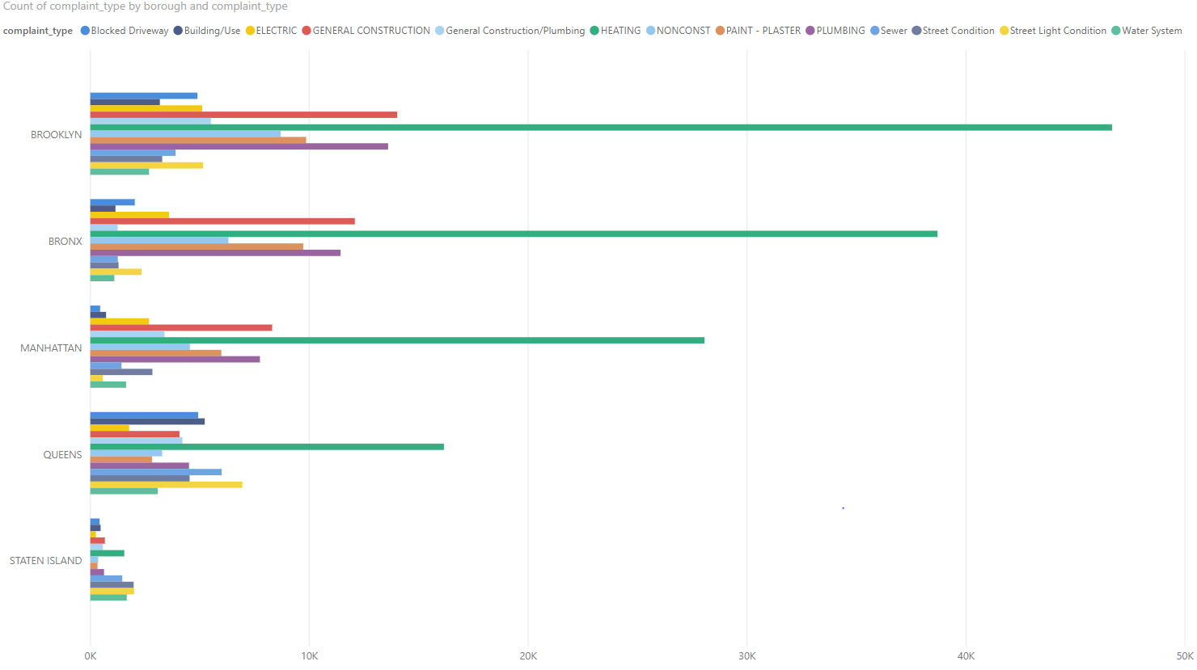

Slide 14
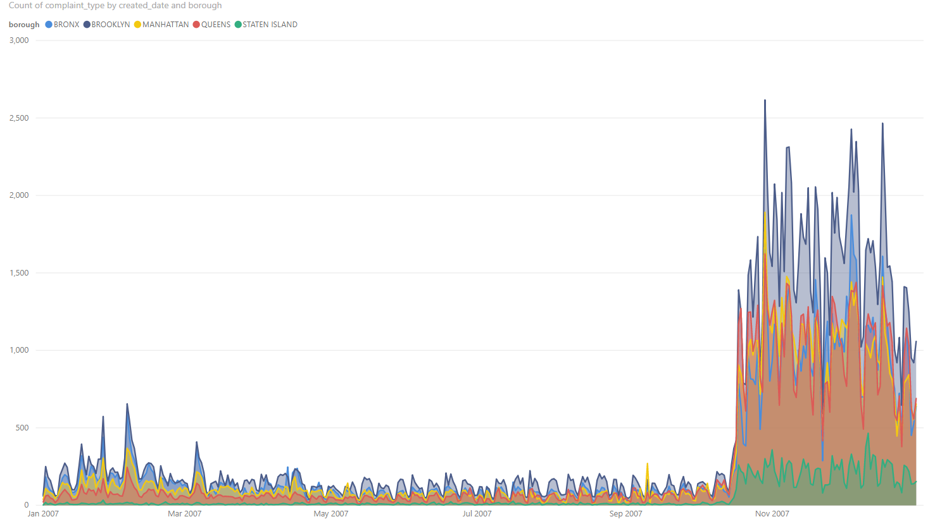

Slide 15
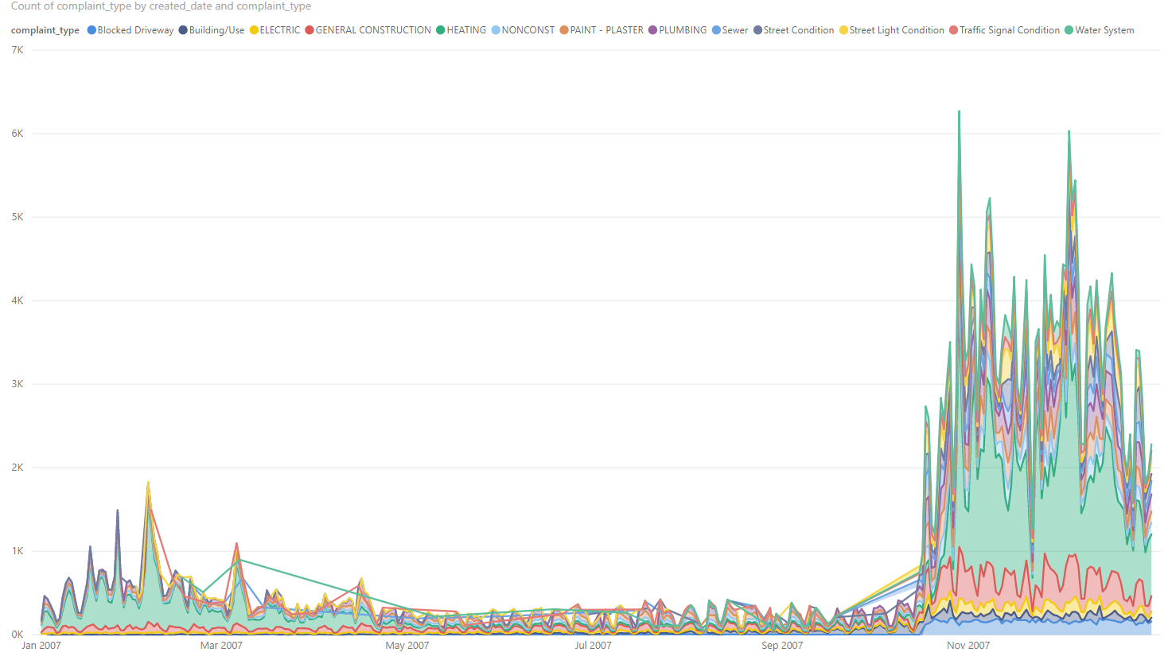

Slide 16
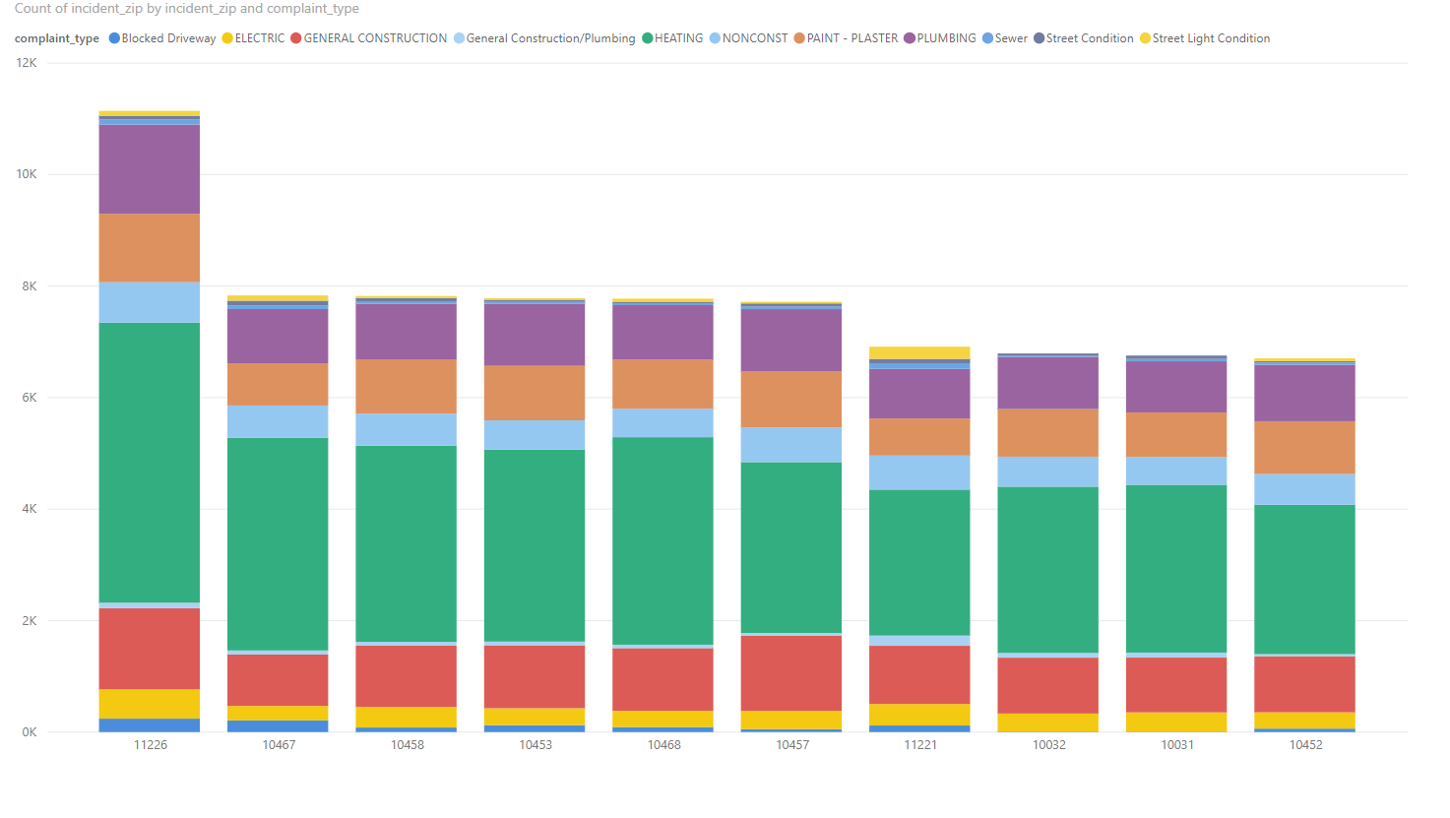

Slide 17
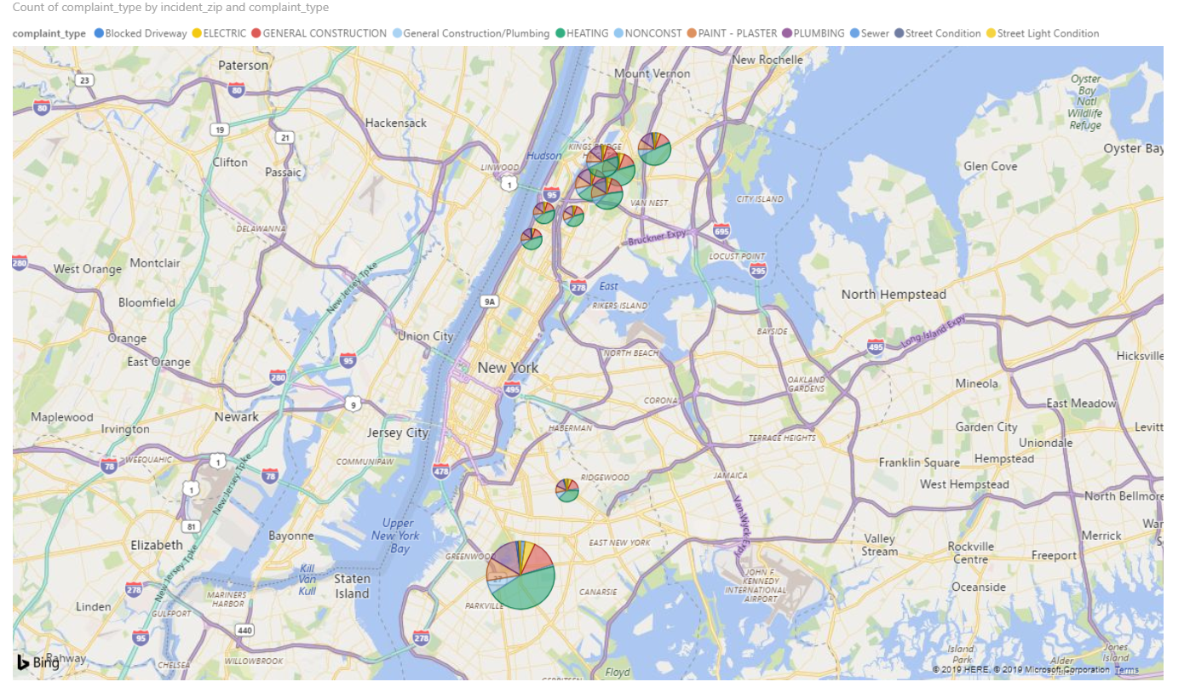

Slide 18
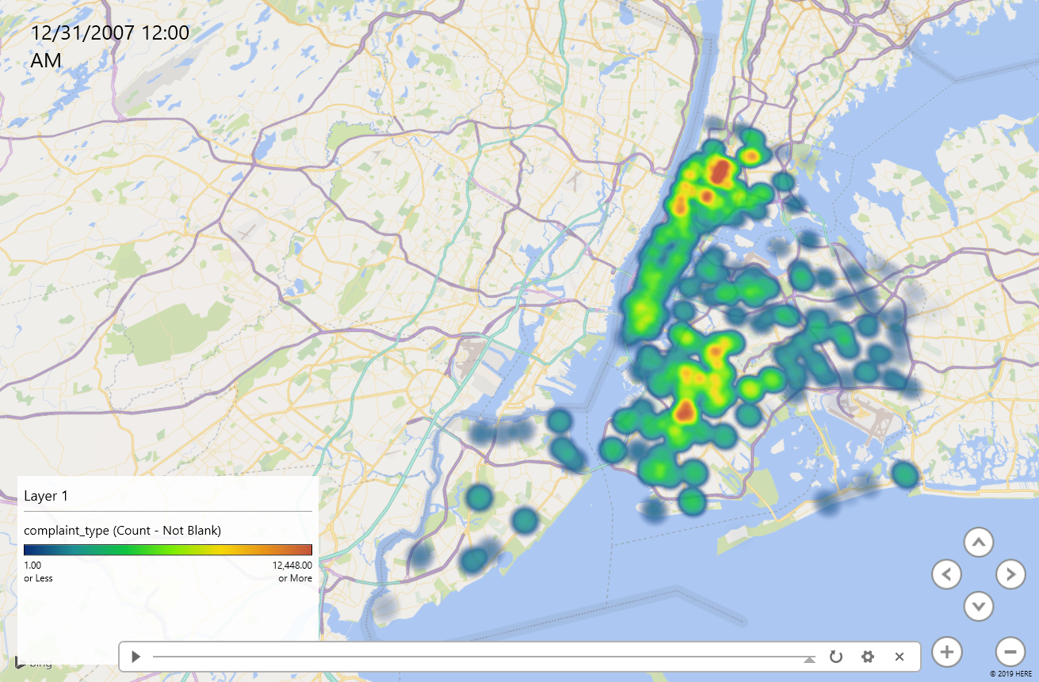

Slide 19
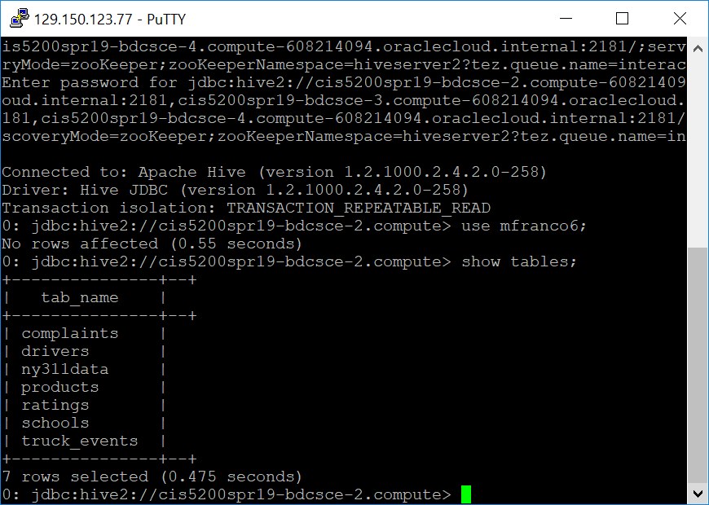
School complaint data (external tables to be compared ny311data & schools )
Create table ny311data that contains main data set and the values to be further analyze to understand school complaints and their due dates:
CREATE EXTERNAL TABLE IF NOT EXISTS ny311data(school_name
Show tables:

Slide 20
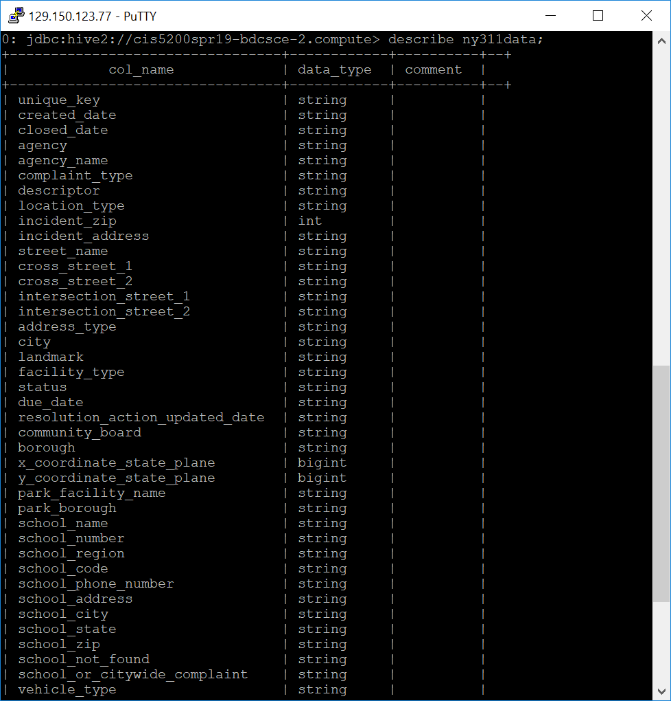
TABLE 1: ny311data
Describe ny311data:

Slide 21
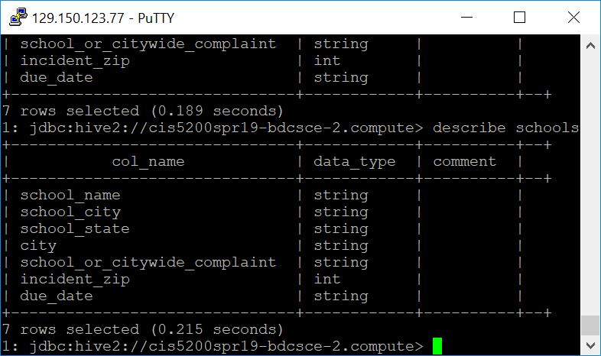
School complaint data (gather geographic location, complaint & due date to be analyzed)
Create a table that stores schools, their location along with corresponding due date for complaints:
CREATE EXTERNAL TABLE IF NOT EXISTS schools(
school_name STRING,
school_city STRING,
school_state STRING,
Describe schools:

Slide 22
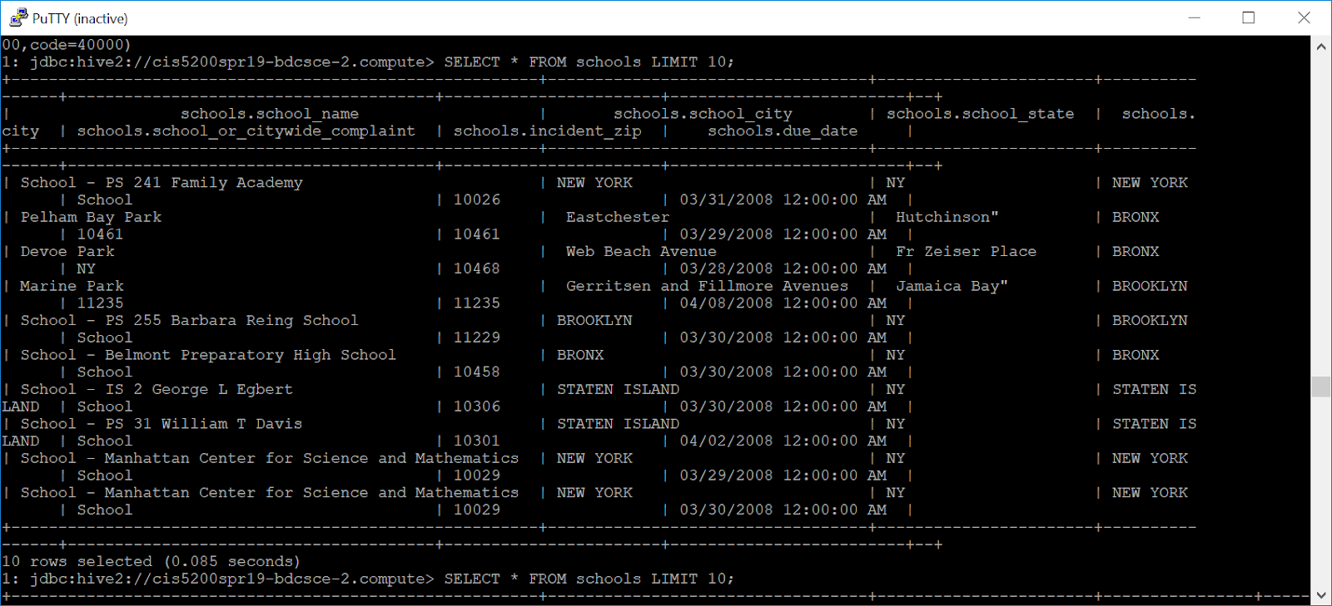
Populating and verifying corresponding values to analyze school complaints, location and due dates based on the fields selected for table ‘schools’
Overwrite data and dismiss null values to organize results:
INSERT OVERWRITE TABLE schools
SELECT school_name, school_city, school_state, city, school_or_citywide_complaint, incident_zip, due_date
FROM ny311data
WHERE city IS NOT NULL
AND school_name IS NOT NULL
SELECT * FROM schools LIMIT 15;

Slide 23
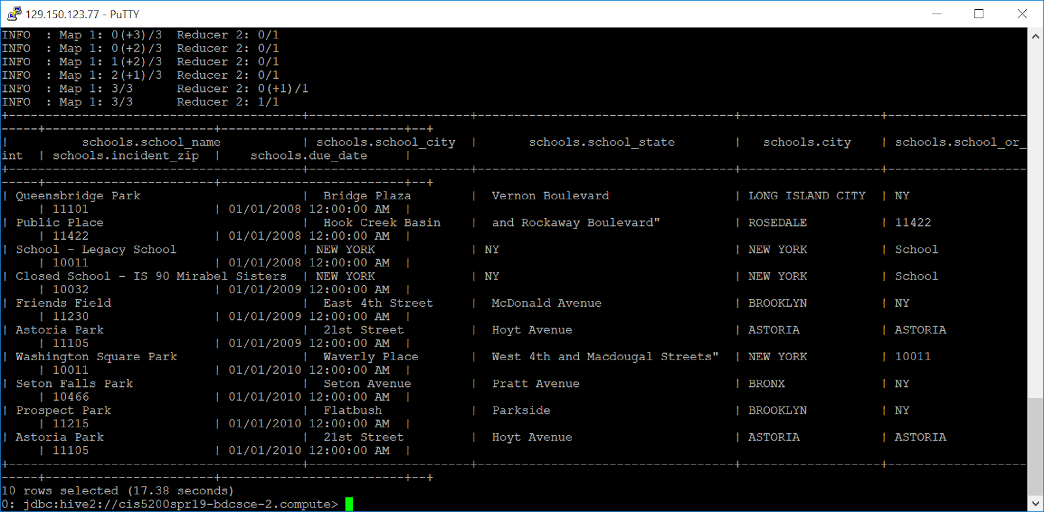
Lastly, Organize School complaints results in ascending order based on their “due_date”
SELECT * FROM schools ORDER BY due_date ASC LIMIT 10:

Slide 24
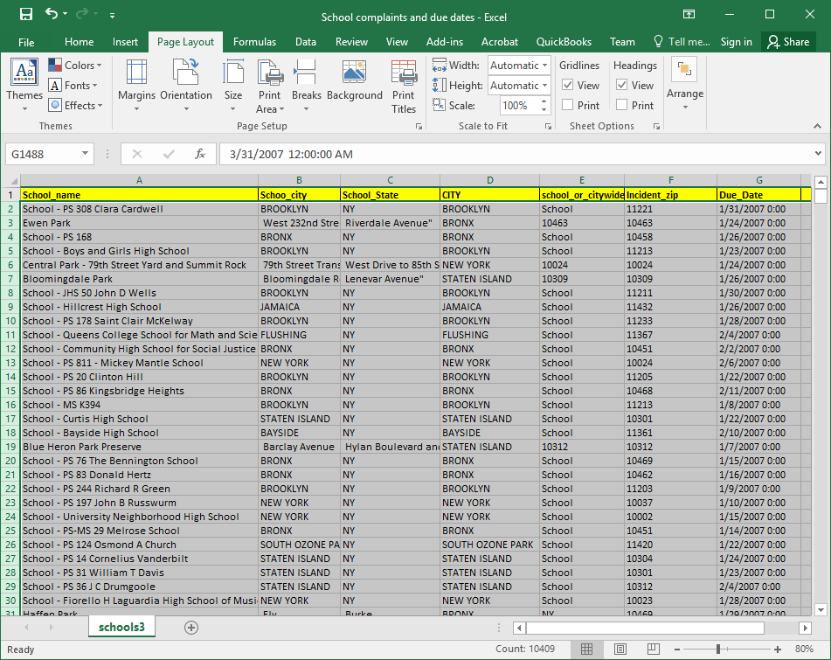
Lastly, Extra file 000000_0 from hdfs server to local pc and conver .csv file to .xsls.
Final result: A total of 10,409 records were obtained based on Hive tables created to analyze school complaints, geographic locations and due dates. All Data was separated in columns and not as single line record:

Slide 25
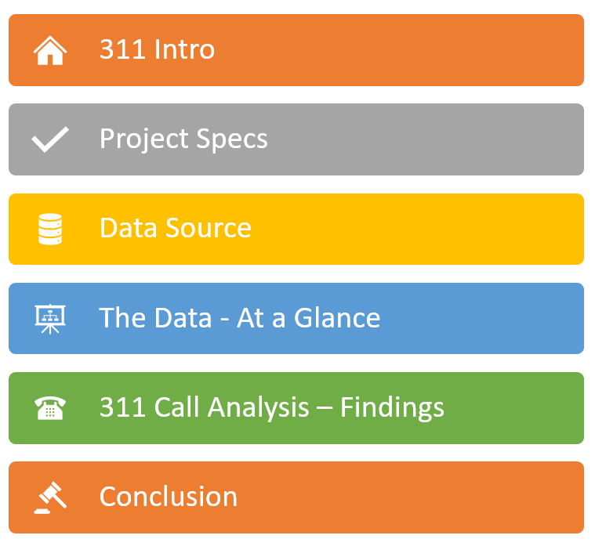
Summary

